Slide 1
INSURANCE CONSULTING Ayyan Asif-st 511
Here is where the dream comes true

Slide 2
Slide 1: Background
The medical malpractice is one of the most important financial issues in the United States health care burden.
The cost of medical malpractice in the United States is $55.6 billion annually, which is 2.4% of total healthcare spending.
During the period 1991 to 2005, 7.4 percent of all physicians licensed in the US had a malpractice claim.
These high cost plays an important role in rising healthcare prices and increased insurance rates.

Slide 3
Slide 2: Methods
Descriptive Analysis: - Histograms and bar graphs will be used to get the results of the distribution of the variables. Claimants, the severity of claims, claim payment amounts, and representation by private attorneys. Regression Analysis: - Linear regression will be utilized to examine the relationship. - Between claimant age and claim payment amount. - Between the severity of the claim and the payment amount. - slope and p-value of regression are analyzed of regression lines, for insights into the relationships. Comparative Analysis - A separate regression analysis will be conducted for claimants with and without the representation of the private attorney. - How the presence of an attorney influences the severity of payment relationship. Statistical Analysis. - The p-value will be assessed to the statistical intent of the observed relationship. - The p-value < 0.05 indicates a statistically intent relationship.

Slide 4
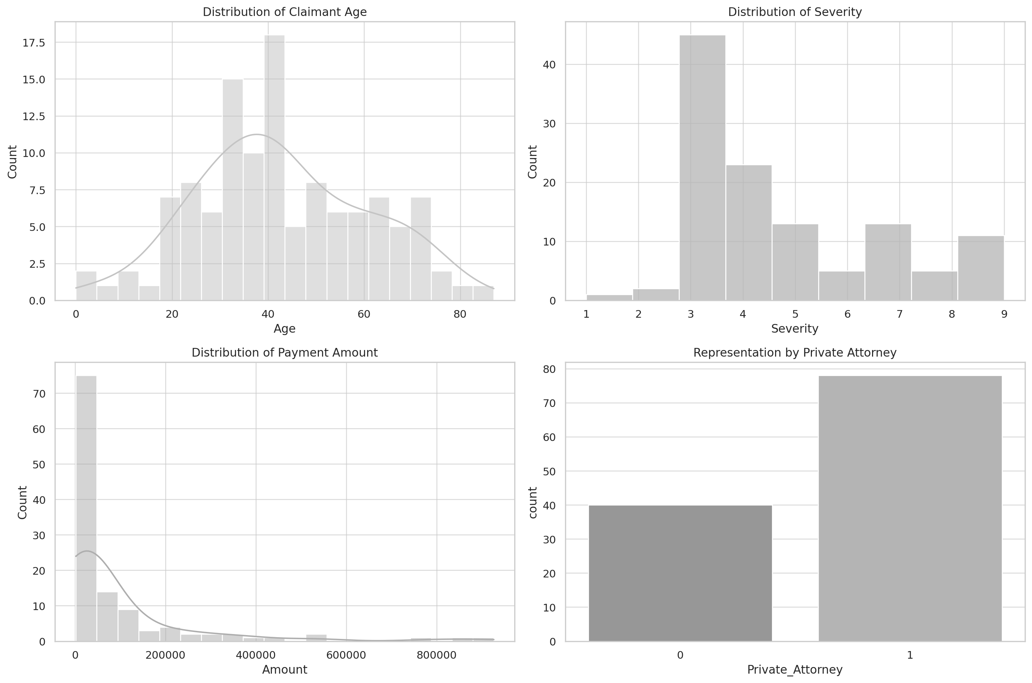
Slide 3: Question 1 Results
Age of the Claimant
- The range from 0 to 87 years, and the average is approximately 43 years.
Severity
- The scale from 1 to 9, average severity is approximately 4.7, that indicates the average level of damage.
Size of the payment
- The range from the $1,550 to $926,500 with the average claim amount of about $91,045
Private Attorney Representation
- The 66% of the claimants were represented by a private attorney

Slide 5
Slide 4: Question 2 Results
Regression Results:
- The value of the R-squared is low as 0.003, indicating that age that explains a very small fraction of the difference in the payment. sizes.
Slope of the Regression Line:
- The slope is approximately -534.91 this shows that for each year in the age, the payment got decreased by about $534.91.
P-value
- The p-value is related with the age of coefficient is 0.529, that is higher than the significance level of 0.05. This shows the relationship between the age of the claimant and the size of the payment that is not statistically substantial.
Correlation Test:
- The Pearson of the correlation between the age and the payment size is -0.0585, with a p-value of 0.529, further that shows the lack of the substantial linear relationship.

Slide 6
Slide 5: Question 3 Results
Regression Results:
- The value of the R-squared is 0.149, shows that the severity explains the moderate amount of variance in the payment size.
Slope of the Regression Line:
- The slope is approximately 30,586.80 this shows that for each level of severity, the payment got increased by about $30,586.80
P-value
- The p-value is related with the severity of coefficient is 1.53e-05, that is lower than the significance level of 0.05. This shows the relationship between the severity and the size of the payment that is not statistically substantial.
Correlation Test:
- The Pearson of the correlation between the severity and the payment size is 0.3866, with a p-value of 1.53e-05, further supporting the significant positive linear relationship.

Slide 7

Slide 6: Question 4 Results
Analysis for Claimants with Private Attorney:
- Regression Results: The R-squared value is 0.084, that shows the average relationship between the severity and the payments size for claimants with the private attorneys.
- Slope: The slope is 25,469.75 that suggests that for each severity level, the payment got increased by the
$25,469.75 for the claimants with the private attorneys.
- P-value: The p-value is approximately 0.0102, indicating the relationship that is statistically important, less strong as compared to the claimants without the private attorney.
Analysis for Claimants without Private Attorney:
- Regression Results: The R-squared value is 0.503, that shows the strong relationship between the severity and the payments size for claimants without the private attorneys.
- Slope: The slope is 30,280.02 that suggests that for each severity level, the payment got increased by the $30,280.02 for the claimants without the private attorneys.
- P-value: The p-value is approximately 2.98e-07, indicating the highly statistically significant relationship.

Slide 8
Slide 7: Implications for insurance company
- The age claimant does not directly impact on the claim payment amounts, as considered the other factors that is more important in assessing the claim risk.
- Severity of the claim is a key determined of the amounts of payments, emphasizing the need for the assessment of the claim severity is the risk management.
- The function of the private attorney in claims: while the presence indicates higher payments, the effect of the claim severity on payment amount is bolder without them, as the strategies in dealing with the represented and the non-represented claimants.

Slide 9

A PICTURE IS WORTH A THOUSAND WORDS

